Slide 1
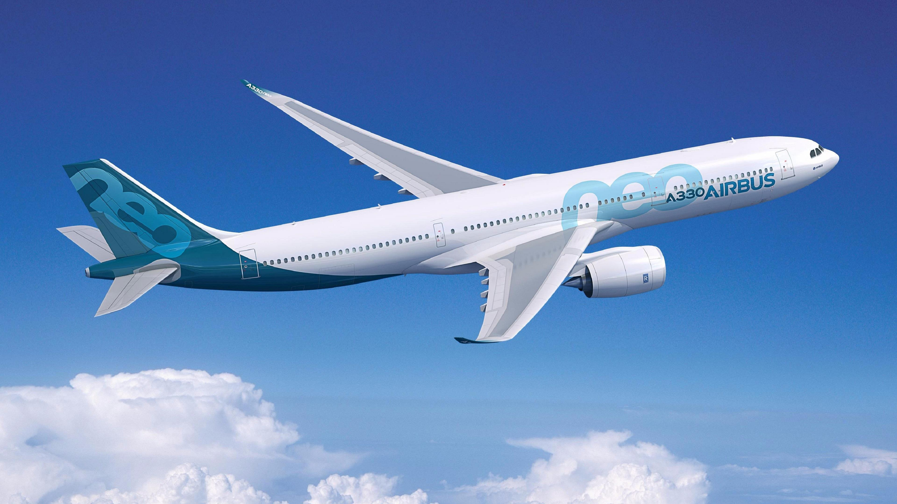
AIRLINE TICKET BOOKING AND CONFIRMATION SYSTEM
By
Harshith Chowdary Meduri (21CS10042)
Vikhyath Gummadi (21CS10028)
Nihith Maddi (21CS10040)

Slide 2
Purpose
After the pandemic situation everybody wants to be as safe as possible. This implies in every aspect like travelling, schools etc.
So we have built an Airline Booking system which verifies vaccination status of every passenger and then confirms their ticket, making the journey of all passengers more safer.

Slide 3

IMPORTANCE OF PROJECT
The Covid-19 pandemic has created a lot of problems in airline industry.
Many flights have become the carriers of virus from one place to another place. Due to this many restrictions were imposed on flight journeys.
Passengers also were concerned about safety measures which made them hesitant to fly.
In sight of passenger’s safety, we have designed a prototype of Airline Ticket Booking System which confirms the tickets of passengers only after the verification of their COVID vaccination certificates.
Our prototype of the airline ticket booking system is the first one to verify vaccine certificates online by scanning the QR code on the certificate.

Slide 4

SOFTWARE FEATURES
Our Software provides the following features -
Register
Login
Reset Password
Profile
Booking
Payment

Slide 5

HOME PAGE
As the user enters our website link he will see the home page which consists of 3 tabs on NavBar – Login, Profile, Contact.
To book airplane tickets you must create an account.
If you have an account then you can click on login page, enter your credentials, and then you can book your tickets.
If you don’t have an account then click on the login tab and at the bottom you can see register button. Click on that button and register yourselves into the website. Now you can book tickets.

Slide 6

LOGIN
REGISTER
The user has to click on the Login tab and login to website inorder to avail all features.
If user is already registered customer then he/she can directly enter his credentials and login to our website.
First he has to enter his Username.
If the username doesn’t exist then an appropriate message will be displayed
If the username exist then the page changes and now he should enter the password.
If the password entered is wrong then an appropriate message will be displayed.
If the user enters a correct password then he will be directed to profile page.
If the user is a new customer then he must create an account to avail all features.
To register, first click on the login tab.
At the bottom you can see a register button. Click on it.
There you need to fill 3 boxes
Username
Password
Email id
If the Username matches with that of existing one of other user then “user already exists” message pops up.
If the email id matches with that of an existing one’s then “email already registered” message pops up.
If there’s no such issue then you are successfully registered and you will be redirected to profile page.

Slide 7

PROFILE
UPDATE PASSWORD
After successful registration you will be redirected to new page where you can update the following details –
First Name
Last Name
Mobile Number
Address
Profile Photo
It has 2 more buttons
Update Profile
Logout
If the user clicks on update Profile button then a blank profile box will be shown where he can fill only the above details again.
And after clicking the update button at last his profile will be updated with a message “” and he will be shown his updated profile.
If he clicks on logout button then he will be redirected to
If the user forgets his password then he can update his password.
To update the password first go to home and click on login button. Enter your username. Then you are directed to a new page where actually you have to enter your password.
In the same page at the bottom you can see “Recover Now” button. Click the button.
Now user is directed to a new page where he needs to enter the OTP which is sent by system to his email id.
If the OTP doesn’t match then message ”” pops up.
If the OTP matches then he will be redirected to a new page where he finds 2 boxes. In the first box have to enter your new password and in the other box you have to enter again the new password for confirmation.
If the password satisfies all minimum criterion then his password is updated successfully.

Slide 8
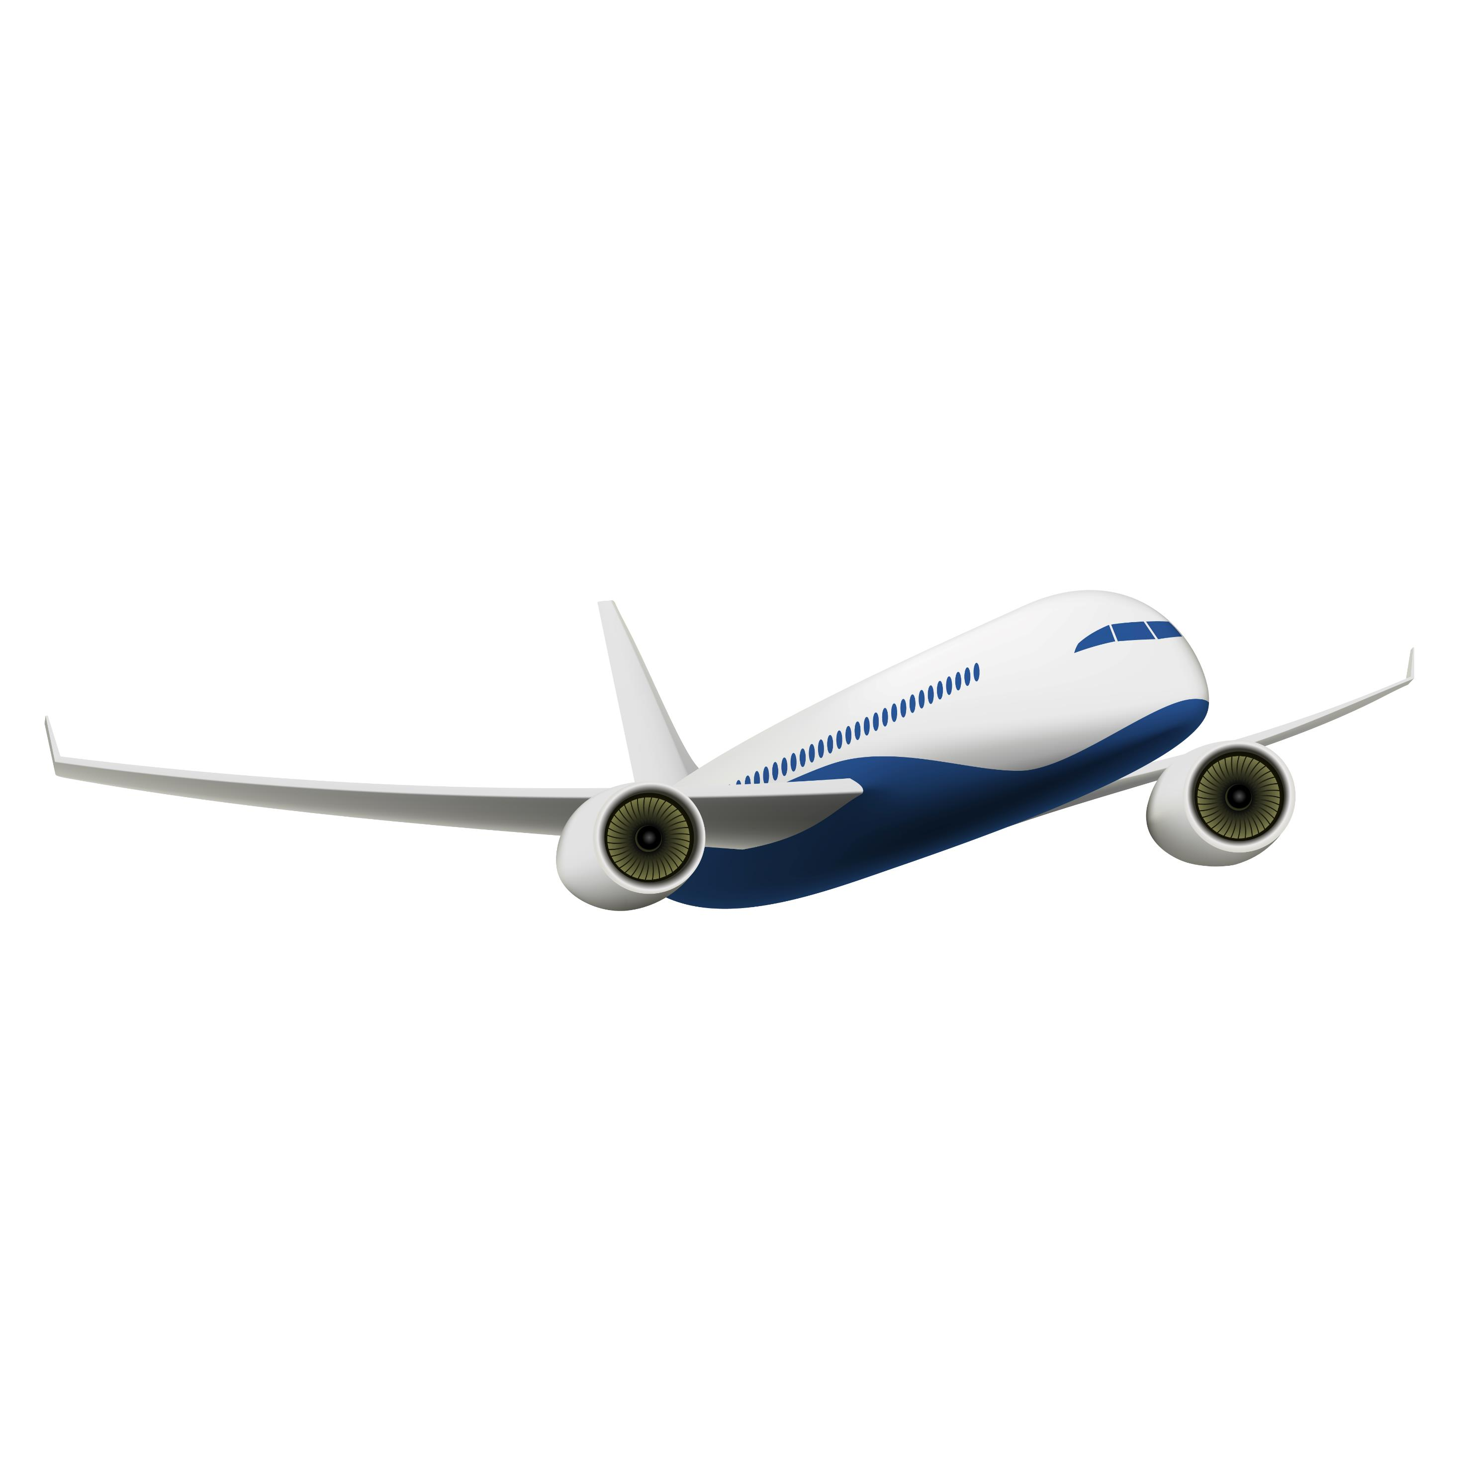
BOOK FLIGHT TICKETS
After successful login to the website the user now can book flight tickets.
In the booking ticket page user has to select the destination and boarding airports, date of journey, number of adults, children, elders who will be traveling, Ticket class.
Then user has to enter Name, E-mail id and cowin certificate of all the passengers travelling.
The system will scan the QR-code on the covid certificate and validates it.
If all the certificates are verified successfully then the user will be taken to payment gateway.
If any one of the certificate is held invalid then the booking will be rejected.

Slide 9

PAYMENT
After successful verification of vaccination certificates of all the passengers the user will be taken to payment gateway.
The payment gateway is made using Stripe and we can test our transactions.
After Successful transactions the flight ticket details will be mailed to user which consists of source and destination airports, passenger details, flight arrival and departure timings.

Slide 10

CHALLENGES
The Challenges that we faced in the project are
Verification part
Adding Payment Gateway
The verification part is done using Python and Selenium
We added payment gateway using Stripe

Slide 11

Programming Languages used
Java Script
Python
Frameworks used
Tailwind CSS
React-Bootstrap
Libraries used
Javascript :
React, Zustand, Axios, Formik etc…
REST API, Express, Cors, Morgan, Node etc…
Python :
Selenium, Pyvirtualcam
Libraries used
Javascript :
React, Zustand, Axios, Formik etc…
REST API, Express, Cors, Morgan, Node etc…
Python :
Selenium, Pyvirtualcam

Slide 12

WHY MERN STACK?
JavaScript is a light-weight object-oriented programming language that is used by several websites for scripting the webpages.
Frontend and Backend parts of website are built directly using libraries of Javascript.
MongoDB is a document-oriented NoSQL database which is flexible and easy to use.
MERN stack includes Node.js features allowing for asynchronous task management which enhances the application’s ability to handle heavy traffic and data-driven applications, leading to faster and efficient Performance.
MERN stack is highly secure with inclusion of some libraries and gives a completely DYNAMIC Application which is more user-friendly and cost & time saving at the same time.

Slide 13
IMPROVEMENTS
The system could be designed to personalize the booking experience for each traveller taking into account their preferences and past history.
The system could be designed to provide travellers with more timely and accurate information about their flights.

Slide 14
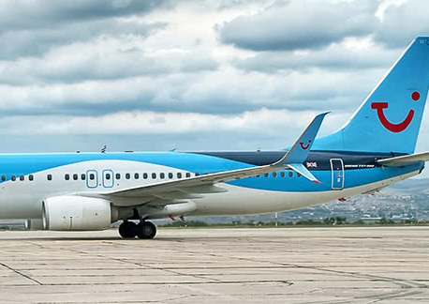
CONTRIBUTIONS
AIRLINE PORTAL – HARSHITH CHOWDARY, NIHITH
BOOKING PORTAL – VIKHYATH, HARSHITH CHOWDARY
PAYMENT – NIHITH, HARSHITH CHOWDARY
COWIN VERIFY – HARSHITH CHOWDARY
AIRLINE DATASET – NIHITH, VIKHYATH
BRANDING – HARSHITH CHOWDARY
TESTING – NIHITH, VIKHYATH
UTILITIES – MongoDB Atlas, Cloudinary, PyPy

Slide 15
LEARNINGS
How MERN stack works and how to Implement MERN
JavaScirpt – Programming & OOPS
Python Selenium Automation
Handling Data and Database
HTTP Requests
Safety and Encryption (bcrypt, cookies, tokens)
GitHub Project Repo : harshith-chowdary/Airline-Ticket-Booking-System (github.com)

